Slide 1
Digital Portfolio
STUDENT NAME: kaviyarasan. S
REGISTER NO :24134121802521018
NMID:autanm41241224ucsc008
DEPARTMENT: bsc. Computer science
COLLEGE: kailaimahal college of arts an science
UNIVERSITY: annamalai university

Slide 2
PROJECT TITLE
. Personal Portfolio Website – A responsive website showcasing my skills, projects, and achievements.
E-Commerce Store – Online shopping website with product listings, cart, and payment integration.
Task Manager App – A simple to-do list app to add, edit, and track daily tasks.
Weather Forecast App – Live weather updates using API integration with location search.
.Blog Platform – A blogging website with categories, post editor, and comment system.

Slide 3


AGENDA
Problem Statement
Project Overview
End Users
Tools and Technologies
Portfolio design and Layout
Features and Functionality
Results and Screenshots
Conclusion
Github Link
3/21/2024 Annual Review

Slide 4

PROBLEM STATEMENT
1. Personal Portfolio Website Problem: Recruiters often miss candidate’s skills because resumes are static and unattractive. 2. E-Commerce Store Problem: Customers face difficulty finding products from local shops without a proper online platform. 3. Task Manager App Problem: Students and professionals lose track of deadlines without an organized task system. 4. Weather Forecast App Problem: Travelers need quick and accurate weather info to plan trips, but existing apps show too much clutter. 5. Blog Platform Problem: Beginners find it difficult to publish and share their thoughts online without technical knowledge.

Slide 5

PROJECT OVERVIEW
The Digital Portfolio Website is a personal platform designed to showcase individual skills, projects, and achievements in a professional manner. It highlights personal branding, creative work, and technical expertise through a clean and interactive interface. The portfolio serves as an online resume, making it easier for potential employers, clients, or collaborators to explore one’s work. Built with HTML, CSS, and JavaScript, it ensures responsiveness, user-friendly navigation, and an engaging experience. This project emphasizes self-presentation, accessibility, and digital presence in today’s competitive environment.

Slide 6

WHO ARE THE END USERS?
1. Students / Job Seekers – Their portfolio shows projects, skills, certificates for placements or internships. 2. Employers / Recruiters – They check the portfolio to evaluate candidate skills and achievements. 3. Teachers / Mentors – To assess student’s work, creativity, and growth. 4. Clients – Freelancers ku portfolio la work samples, services prove

Slide 7

TOOLS AND TECHNIQUES
For creating a digital portfolio, tools like Canva, Google Sites, Wix, WordPress, Behance, and GitHub can be used. These help in designing and showcasing projects easily. To make the portfolio effective, techniques such as clear layout, high-quality visuals, concise descriptions, proper categorization, and adding interactive links are important.

Slide 8
POTFOLIO DESIGN AND LAYOUT
Homepage / Introduction – Short bio, photo, tagline. About Me – Education, skills, background. Projects / Work Samples – Showcase with images, descriptions, and links. Resume / Achievements – Downloadable resume, certificates, awards. Contact Section – Email, phone, or social media links. Navigation Bar – Easy to move between sections.
8

Slide 9
FEATURES AND FUNCTIONALITY
A digital portfolio includes key features such as a profile section with personal details, a project showcase to highlight works, a skills and tools section, an option to upload or download resumes, a contact section, and customization options like themes and layouts. Its functionalities focus on easy navigation through menus, responsive design for mobile and desktop use, search and filter options for projects, interactive elements like animations, sharing or downloading options, and feedback or testimonial sections. Together, these features and functions make the portfolio professional, user-friendly, and engaging

Slide 10
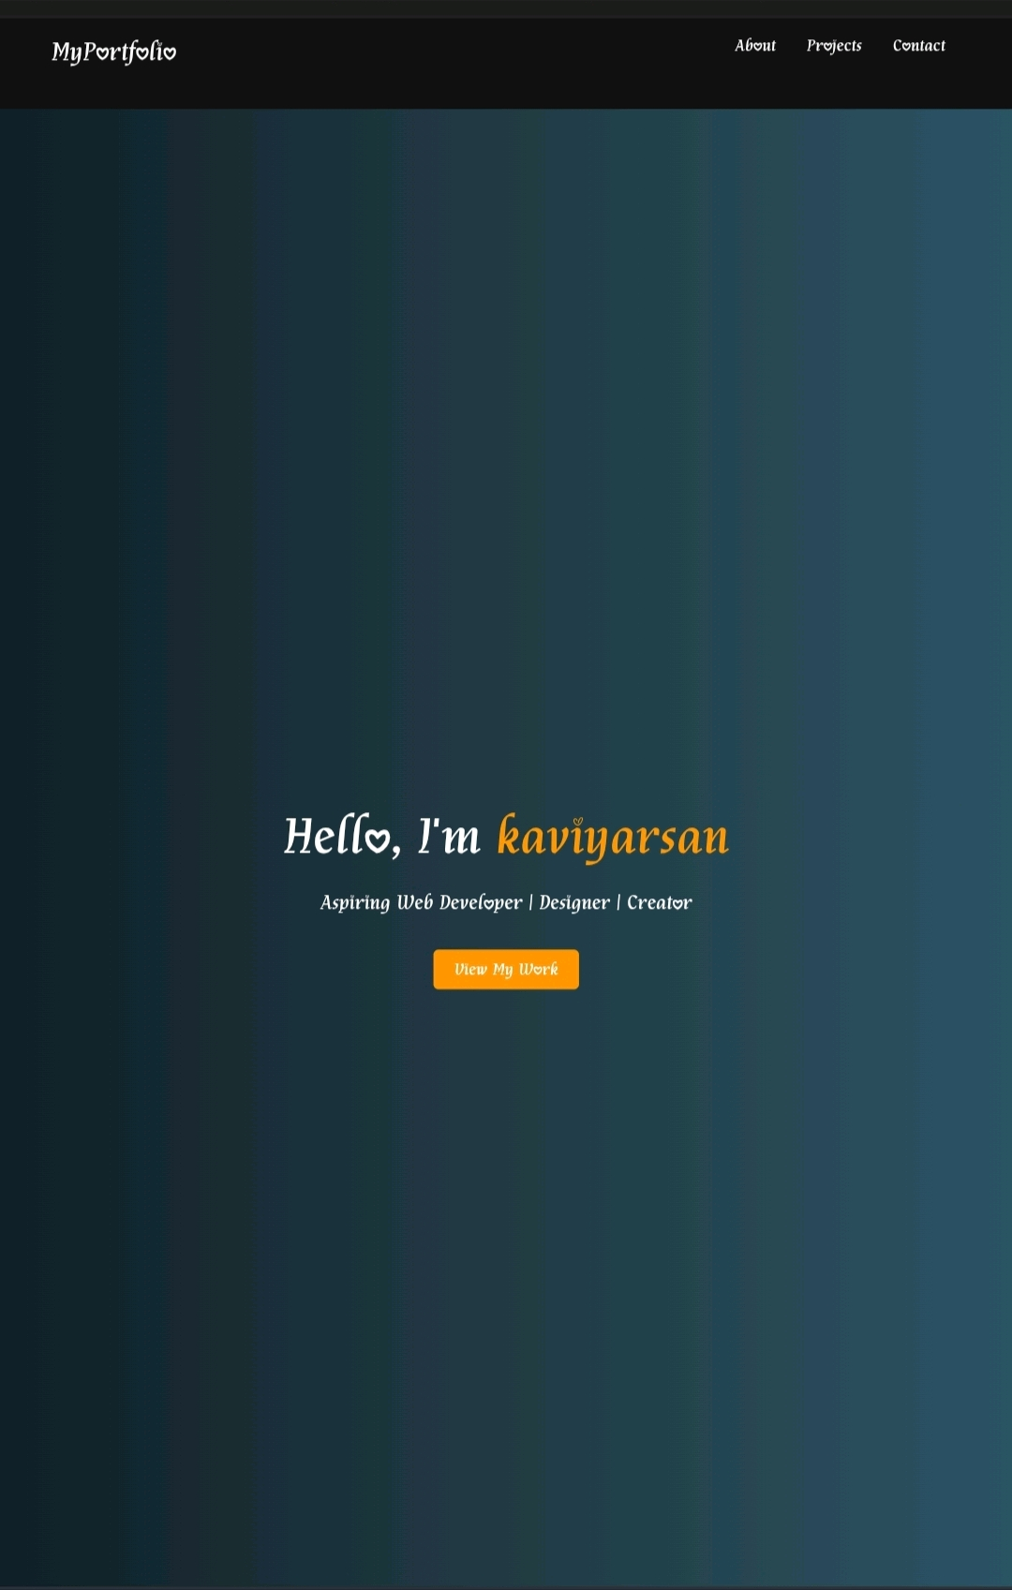

RESULTS AND SCREENSHOTS
3/21/2024 Annual Review
10

Slide 11
CONCLUSION
1. A digital portfolio is a modern way to showcase skills, projects, and achievements. 2. It highlights creativity, professionalism, and technical knowledge. 3. It serves as an effective tool for career growth and opportunities. 4. Digital portfolios provide easy access and global reach to potential employers. 5. Overall, it is a powerful medium to present one’s talent in the digital era.
11

